Slide 1
INTERNATIONAL TAX AUTHORITY
Common Reporting Standard
Compliance Overview
Risk Assessments
New CRS forms
Review of Missing Information

Slide 2
INTERNATIONAL TAX AUTHORITY
Common Reporting Standard
Risk Assessments
The ITA reviews all Financial Institutions (both RFIs and NRFIs) to ensure compliance with the Common Reporting Standard as it relates to:
Due diligence; and
Reporting obligations
NIL filings if there are no reportable accounts
Full information for reportable accounts

Slide 3
INTERNATIONAL TAX AUTHORITY
Common Reporting Standard
Risk Assessments cont’d
Will be subject to a risk assessment, based on:
Responses received from the RFI and NRFI (via questionnaires/forms)
Information filed within the BVIFARS portal
Upon completion of the risk assessment, the FIs will be subject to regular compliance actions based on the risk rating assigned.

Slide 4
INTERNATIONAL TAX AUTHORITY
Common Reporting Standard
Risk Assessments cont’d
Low risk (There is little or no risk for effective compliance). This category is normally reviewed within five years unless there is a trigger event.
Medium risk (There is limited risk for effective CRS compliance). This category is reviewed within one to two years unless there is a trigger event.
High risk (There is considerable risk for effective CRS compliance). This category is reviewed every year until the FI’s CRS obligations are consistently complied with.

Slide 5
INTERNATIONAL TAX AUTHORITY
Common Reporting Standard
Risk Assessments cont’d
Medium and high risk FIs will trigger some form of compliance inspection as informed by the risk assessment. Two (2) types of compliance inspections:
Desk-based Compliance Inspection (S.4C ITA Act or S.32 MLA).
Onsite Compliance Inspection (S.4J ITA Act).
Physical
Virtual
Both

Slide 6
INTERNATIONAL TAX AUTHORITY
Common Reporting Standard
Risk Assessments cont’d
These can be either:
Full Compliance Inspection
Partial Compliance Inspection
Legislative framework - S.4J ITA Act

Slide 7
INTERNATIONAL TAX AUTHORITY
Common Reporting Standard
New CRS Forms
Beginning June 2025, all FIs (Reporting and Non-Reporting) will be required to complete a CRS form electronically via the BVIFARS portal.
Submitted on an annual basis
Subject to change as the compliance strategy and plan of the BVI changes

Slide 8
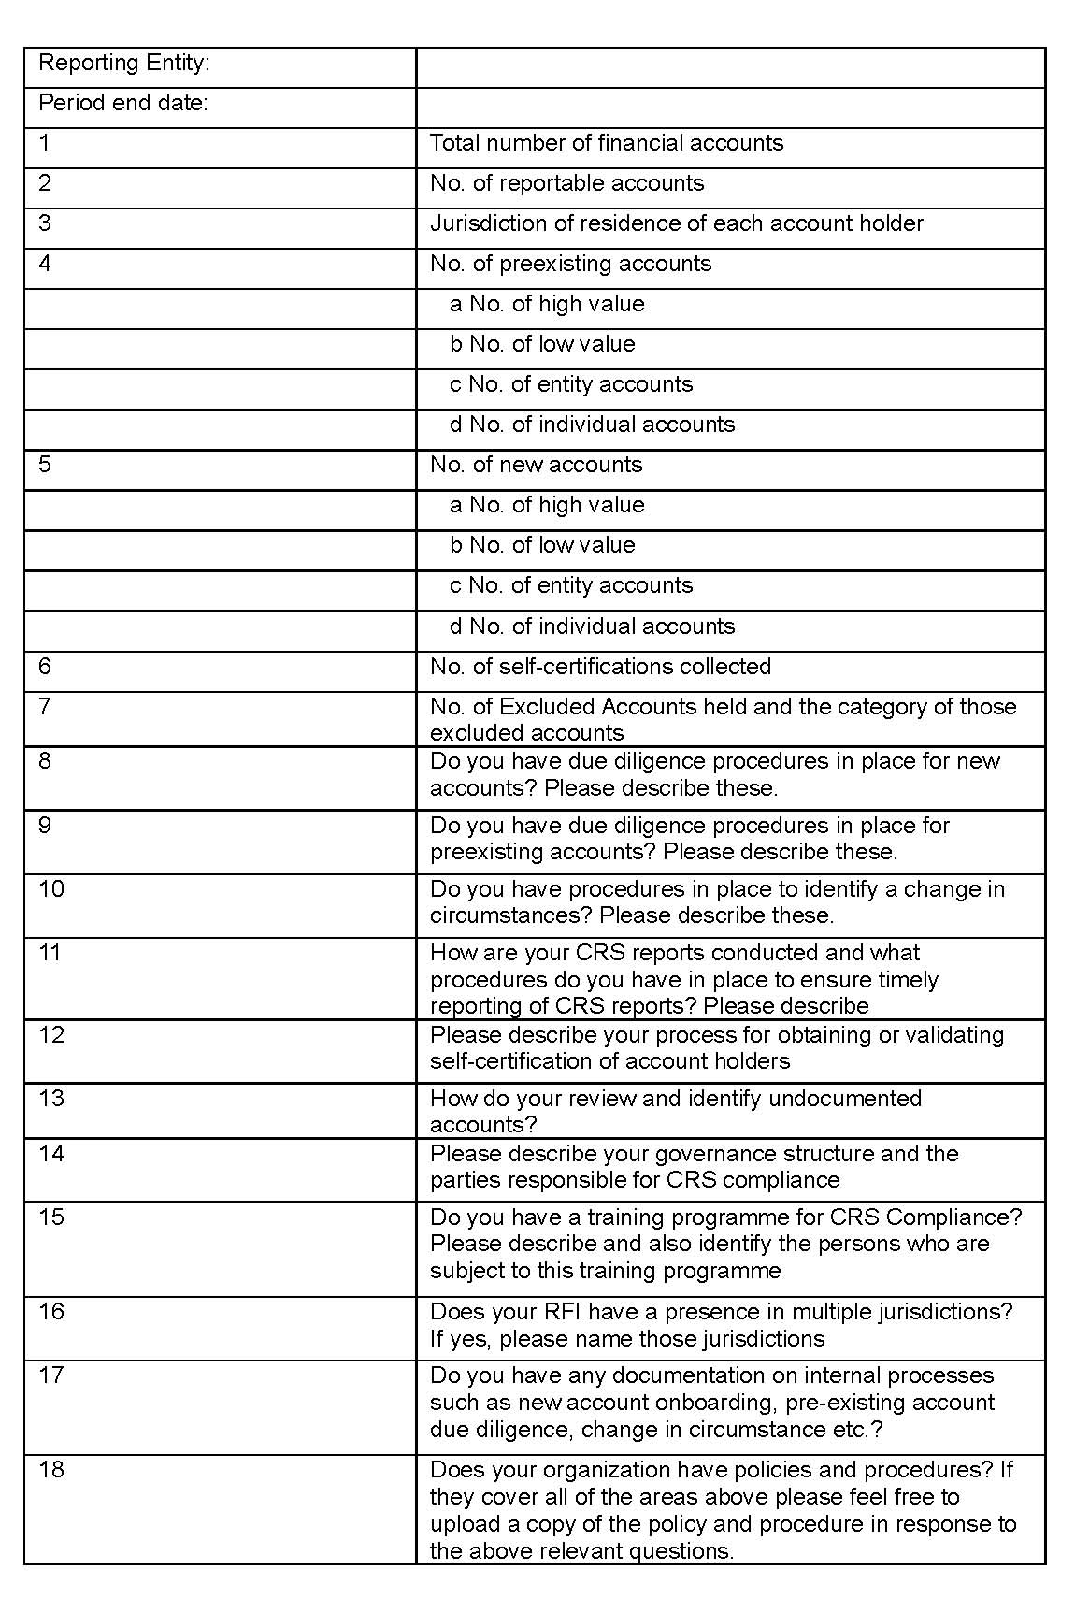
INTERNATIONAL TAX AUTHORITY
Common Reporting Standard
New CRS Forms cont’d - RFIs

Slide 9
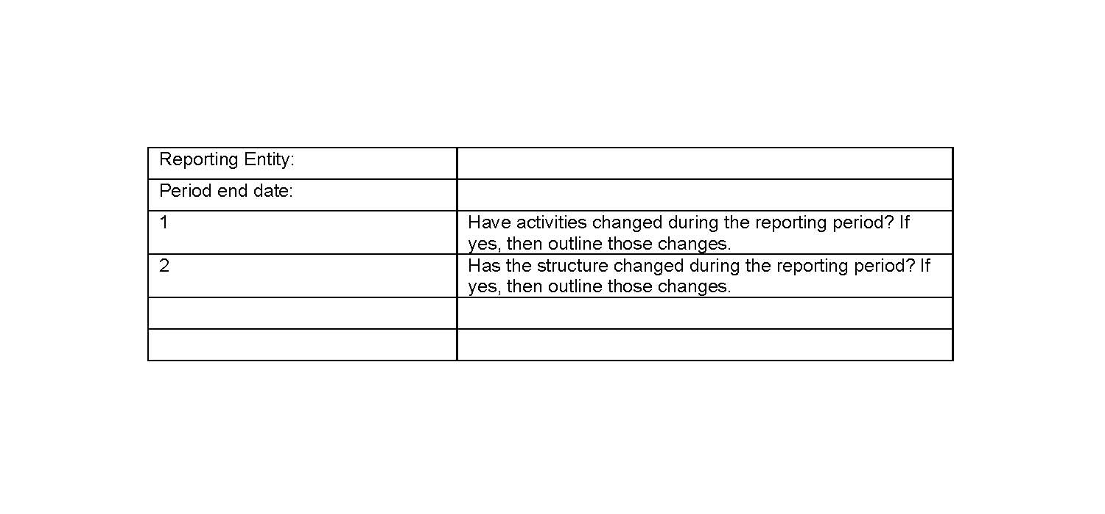
INTERNATIONAL TAX AUTHORITY
Common Reporting Standard
New CRS Forms cont’d - NRFIs

Slide 10
INTERNATIONAL TAX AUTHORITY
Common Reporting Standard
Review of missing information
FIs are reminded that the following information must be included or updated (as appropriate) within the BVIFARS portal for each reportable account:
Name
Date of birth
Address
Tax Identification Number (important to include once it is available)
Jurisdiction/s of tax residence
Account balance or value as at the end of the relevant calendar year or closure of account

Slide 11
INTERNATIONAL TAX AUTHORITY
Common Reporting Standard
Important!
Nudge Letters:
Classification (are you properly classified)?
Are you a Financial Institution (Reporting/Non-Reporting)?

Slide 12
INTERNATIONAL TAX AUTHORITY
THANK YOU!
1-284-394-4415
Peace House, Pickering Drive
www.bviita.vg
info@bviita.vg

