Slide 1
FARS Portal

Slide 2
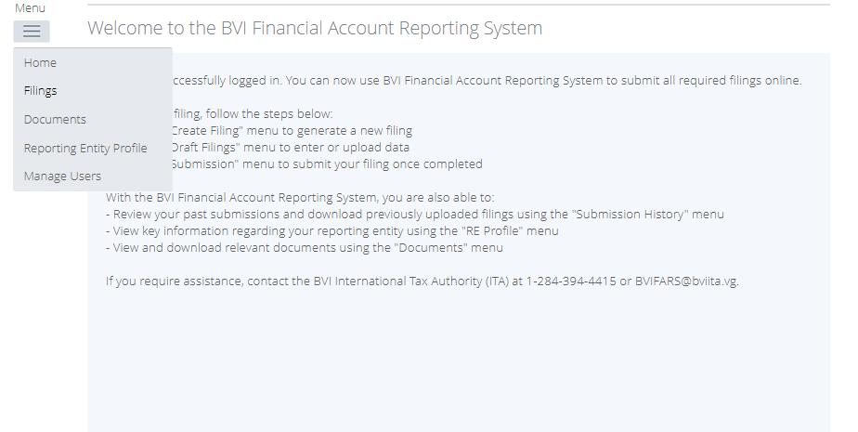
Notes:
From the home page, click Menu and then select Filings

Slide 3
Notes:
Next Click Create Filing.

Slide 4
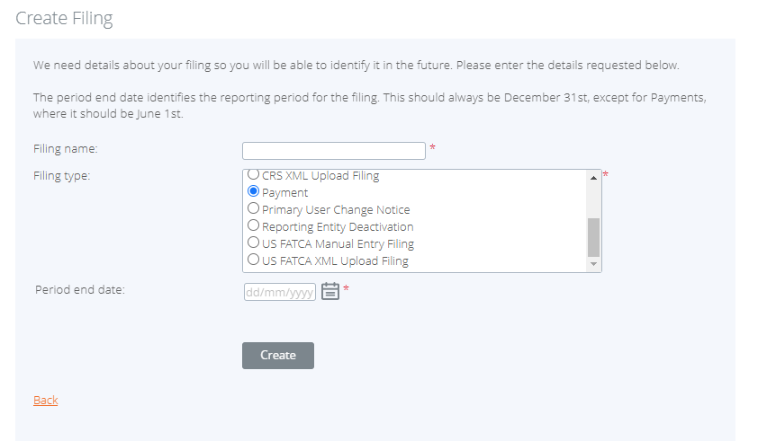
Notes:
Enter the name of the Filing name and for the filing type select Payment. Next enter the Period end date which is 1st June. Finally hit Create.
Note if you’re making payment for one entity, select the option called Payment. If you are making payment for multiple entities select Bulk Payment.

Slide 5
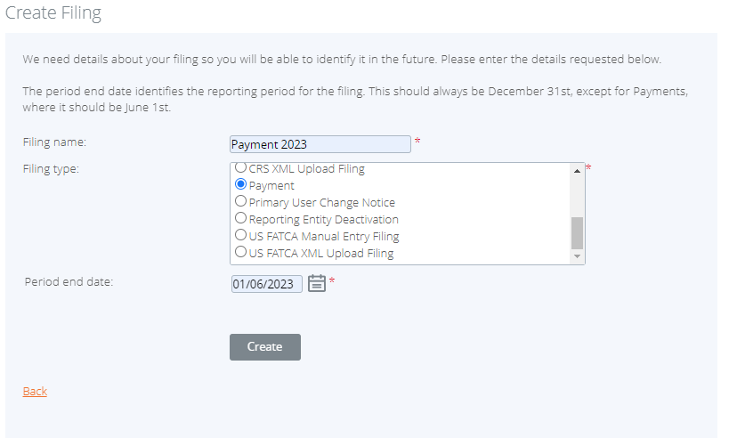

Slide 6
Notes:
Once the filing is created successfully a message would be generated. Next click on the payment filing name in the message.

Slide 7
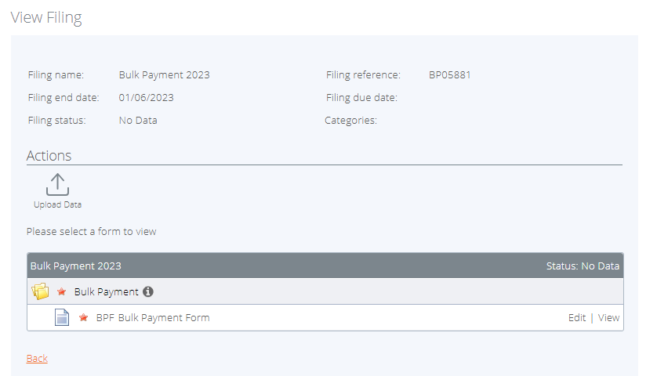
Notes:
The next step is to validate the payment form. To do so click on Edit on the payment form. First I will show you the Bulk payment then the Single payment mention.

Slide 8
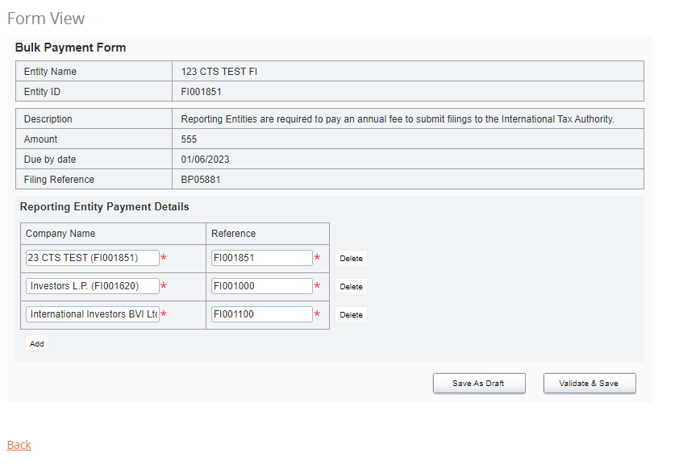
Notes:
Enter all the companies that you are making payments for, by entering their name and reference name in the corresponding fields in the following format Company Name (FI00000) See Figure 1 . To add more companies click Add to create more fields. Once that is completed hit Validate & Save.

Slide 9
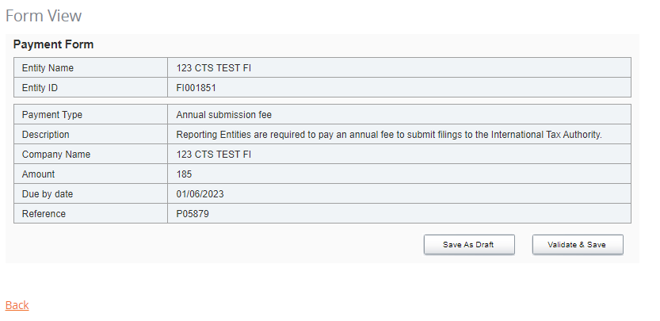

Slide 10
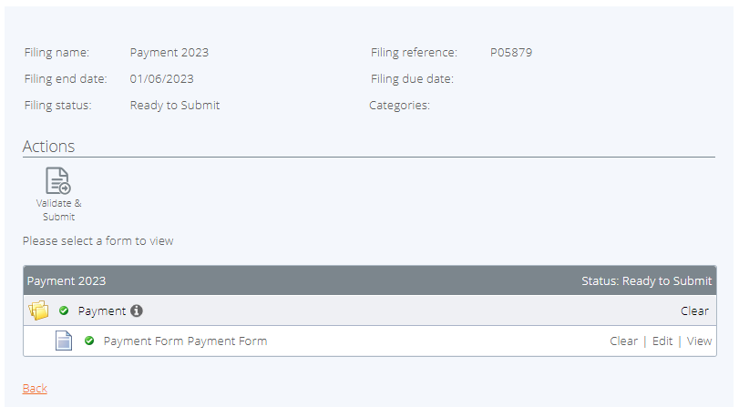
Notes:
Next step is to click Validate and Submit

Slide 11
Notes:
Once all the information is correct click submit.

Slide 12
Notes:
Next, Click Return to Manage Filings

Slide 13
Notes:
To see the filing in order to issue payment, Click View Submissions

Slide 14
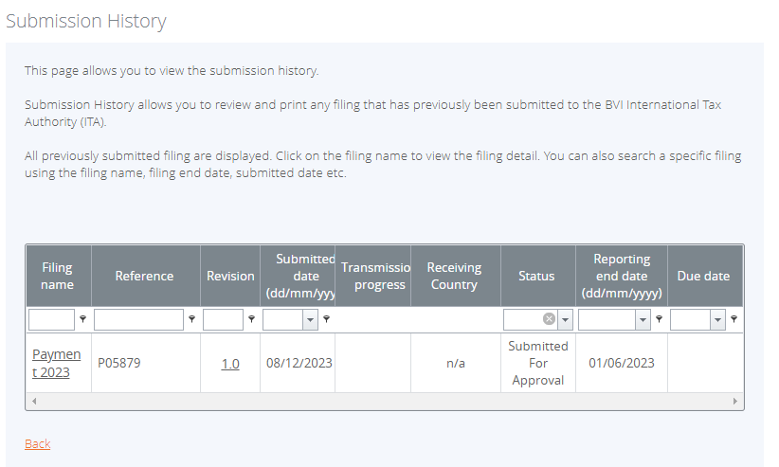
Notes:
Next click on the Filing name

Slide 15
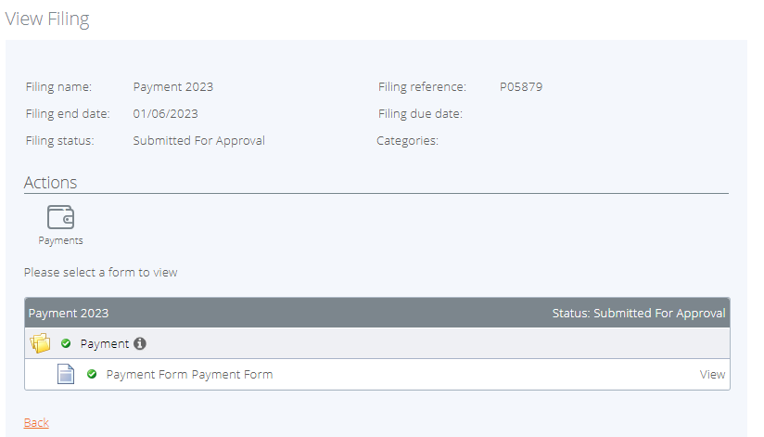
Notes:
Next click on Payments

Slide 16
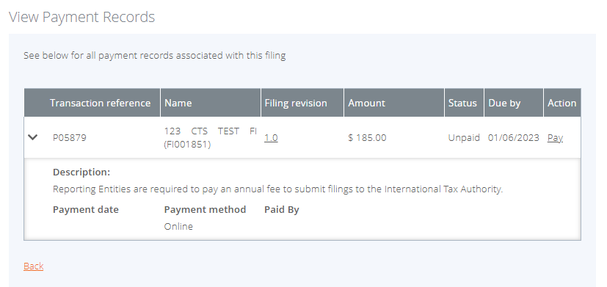
Notes:
Review the information once more then click Pay under the Action Column

Slide 17
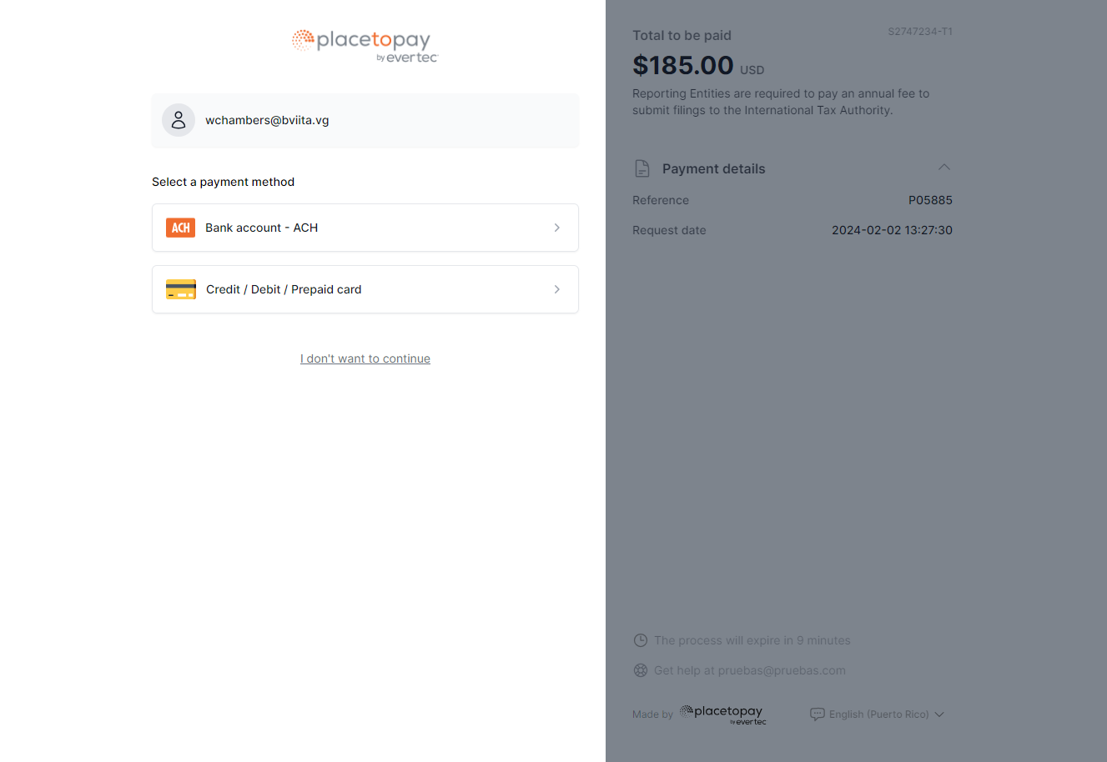
Notes:
When the payment page loads select your preferred payment method.

Slide 18
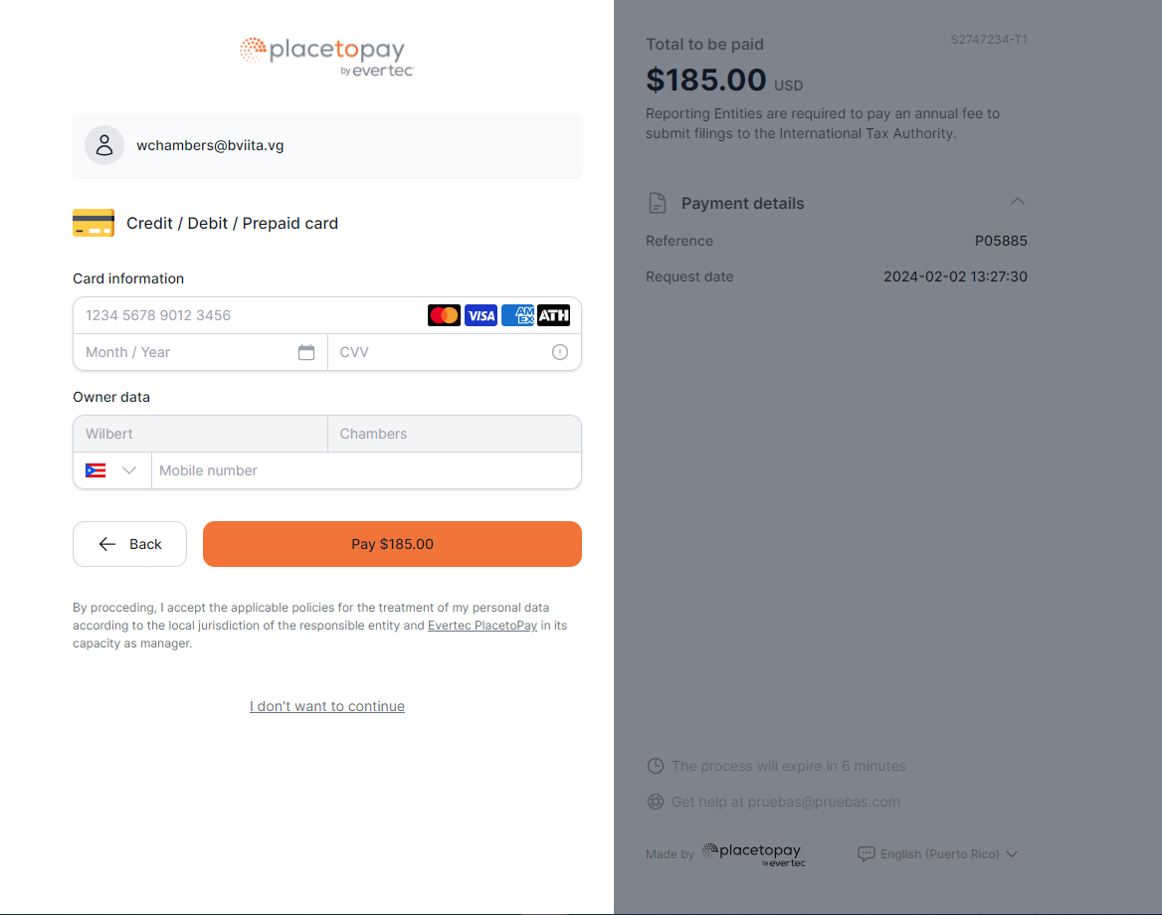
Notes:
Fill in the relevant information required and hit the Orange Pay button.
(NOTE: If the language on the page is not in your native language select it at the bottom right of the page.

Slide 19
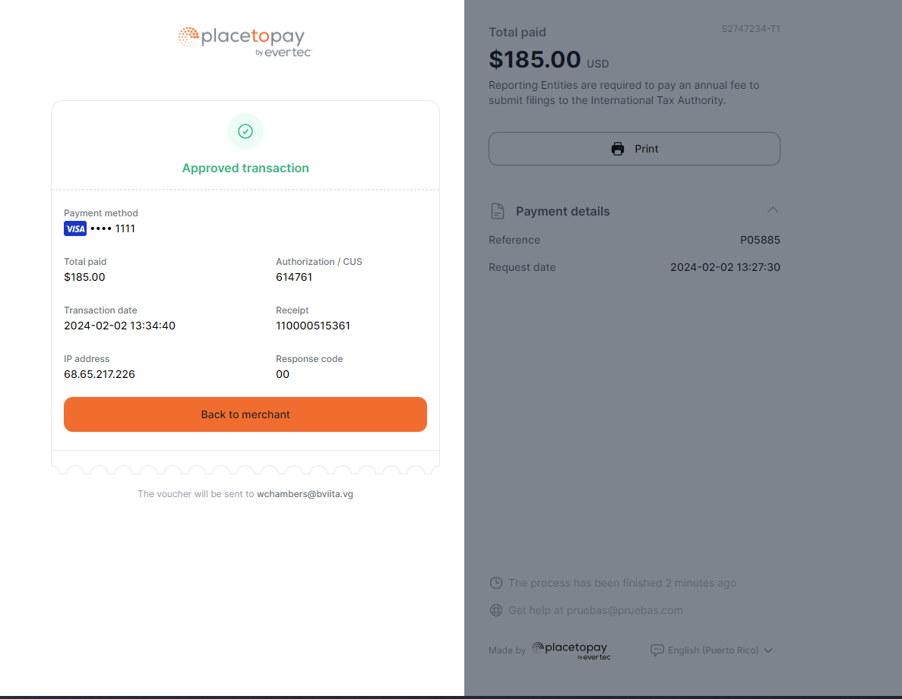
Notes:
After the transaction is completed print or save the payment voucher for your records. Please note it will also be sent to the email address linked to the account that is linked to the account. Click Back to Merchant to head back to the portal ….

Slide 20
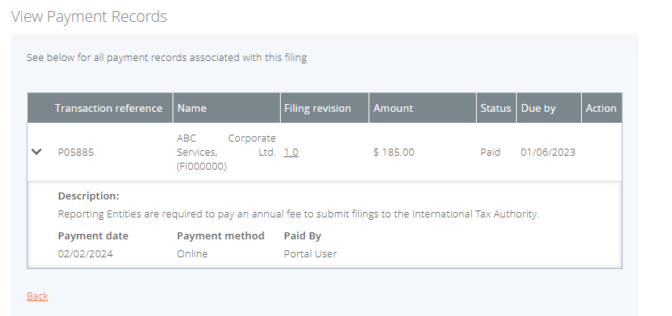
Notes:
….to confirm that the status has changed.

Slide 21
THANK YOU!
1-284-394-4415
Peace House, Pickering Drive
www.bviita.vg
info@bviita.vg

